Slide 1
Automatic configuration systems, the case of Puppet
Andrea Biancini, Consortium GARR
Géant Showcase
January, 23rd 2014

Slide 2
Agenda
What is Puppet?
It’s purpose
How and when it can be used
A use case from our experience
Basic principles
Demo
Installing apache httpd on Windows and Linux
How can we leverage on existing modules
What needs to be implemented

Slide 3

What is Puppet?
Puppet is a framework able to automate repetitive system administration tasks.
Puppet is open source (Apache 2.0 license)
Puppet is available on Linux/Windows/UNIX/…
puppetlabs.com/puppet/puppet-open-source

Slide 4
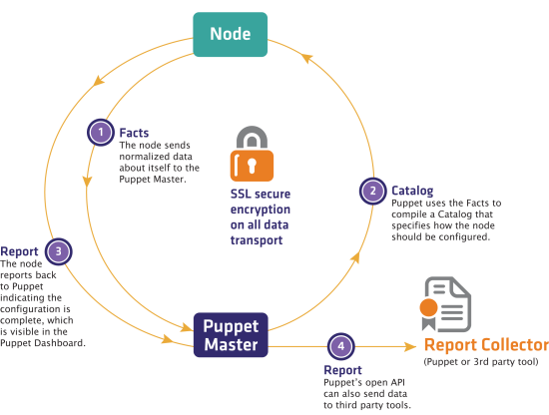
How and when to use Puppet
Puppet can be used to automatize the provisioning and configuration of IT servers and software components in a distributed environment.

Slide 5





Use case from GARR – 1/2
GARR used Puppet to implement a cloud service within the IdP in the Cloud project.
GARR Cloud service provides each organization with a Virtual Machines (VM) including all the software needed to implement an IdP fully compliant to IDEM and eduGAIN requirements.
web interface to manage identities
openLDAP
Identity Provider
Cloud GARR

Slide 6


Use case from GARR – 2/2
The GARR’s Cloud infrastructure is based on OpenStack; Puppet has been used to optimize provisioning (from manual to automatic).
VM provisioning & setup
OS install and configuration
Install of SW prerequisites
Install of Shibboleth and other software
Configuration of Shibboleth (with LDAP MySQL)
Registration of the IDP into the federation
30 minutes
15 minutes
(thanks to a cloud
Infrastructure built with OpenStack)
Automatized process
Manual process
60 minutes
10 minutes
15 minutes
2 minutes
(thanks to the Puppet tool which
automatize installation and
configuration of software)
30 minutes
Total time 2 hours and 25 minutes
>
Total time 17 minutes

Slide 7
Basic principles of Puppet
Everything is described as a resource
Puppet executes transitions among resource states (without a definite precedence)
The final state represents the desired result

Slide 8
Demo – 1/3
Goal: configure two servers (Linux and Windows) to provide Apache HTTPd webserver.
Architecture (demo on VirtualBox VMs):
One VM for the Puppet Master: it has been configured to install apache httpd on the two clients
One VM for the Linux client: fresh installation of Ubuntu server without any additional package
One VM for the Windows client: fresh installation of Windows XP without any additional software

Slide 9
Demo – 2/3
Leverage feely available open source modules
# puppet module install puppetlabs/registry
# puppet module install reidmv/windows_package
# puppet module install simondean/net_share
# puppet module install puppetlabs/apache
create a class to take care of httpd installation
class apache_httpd {
if ($::kernel == ‘windows’) { … }
else { … }
}
create a site.pp on the puppetmaster
import 'apache_httpd.pp'
node 'windowsclient.local', 'linuxclient.local' {
class { 'apache_http' : }
}

Slide 10
Demo – 3/3
All the matherial, code and some documentation for this brief demo is publicly available on:
https://github.com/biancini/PuppetShowcaseDemo
The VMs and more support can be provided, if needed, on request:
andrea.biancini@garr.it

Slide 11
Thank you!

